Slide 1
Power Pages Secure Large Gb File transfer to Azure Datalake by External User Identities Greg Roe App Innovation Cloud Solution Architect Microsoft Federal gregroe@microsoft.com
What Problem are we trying to solve?
Solution Architecture:
Power Portal, Dataverse, Power Automate, Azure Functions, Event Grid
Workflows:
Request Portal Access
Request File Upload Approval and credentials
New File Upload Notification and management

Slide 2
What Problem does the solution solve? What is the value?
Problem:
Organizations need to receive large files from external customers for Data AI workloads.
But since the customers are external and don’t have an AAD Identity how do they get credentials to securely transfer files?
Where are the files stored and how are they managed?
Solution: Power Platform + Azure
Power Pages provide a portal for external users to register, login, and submit upload request forms
Dataverse provides a relational database to store and audit Datalake uploads and other metadata about users, approvals, upload requests, and file location
Power Automate provide automated workflow and backend services
Azure Functions provide an automated way to create SAS Tokens and SFTP credentials Azure Blob Storage
Azure Datalake provides a hierarchical file system and secure petabyte storage at low cost
Azure Event Grid monitors new file upload events and triggers Power Automate file management workflows.

Slide 3
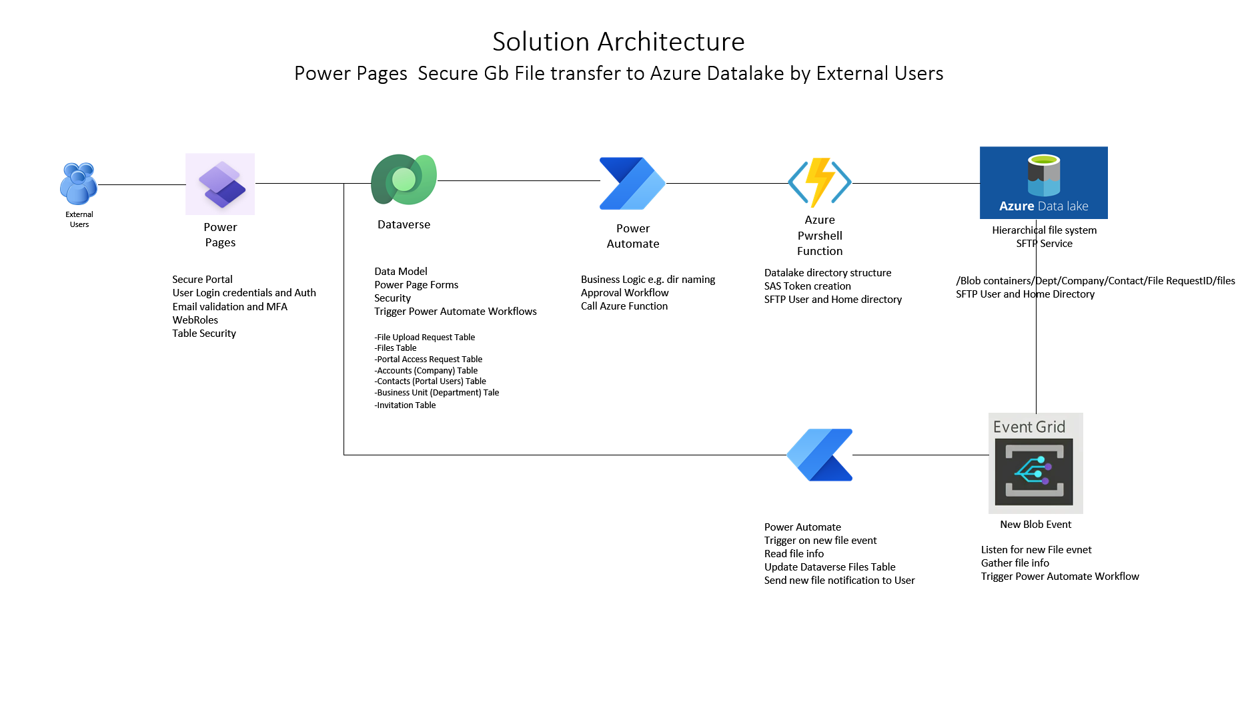

Slide 4
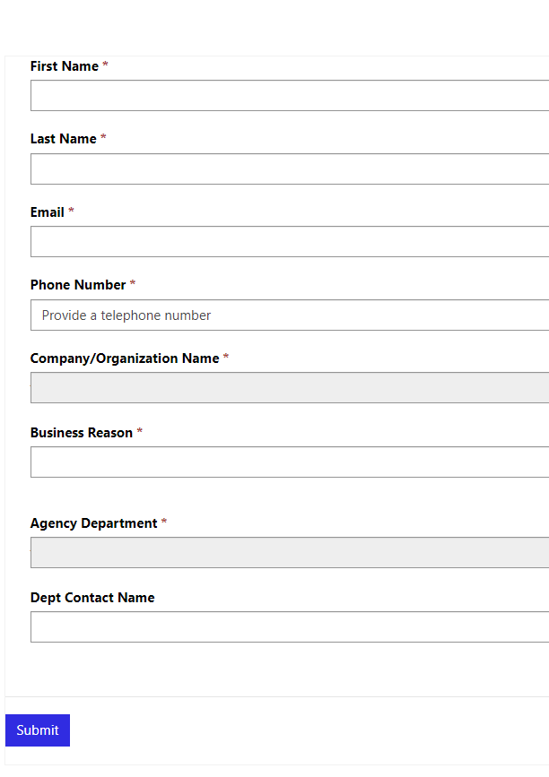





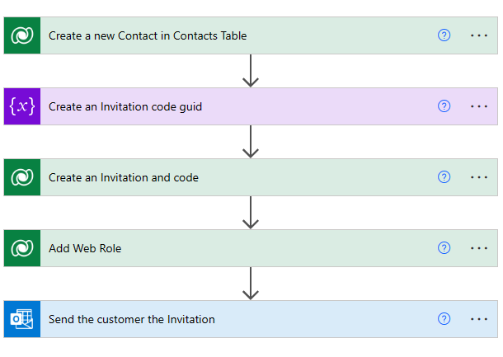
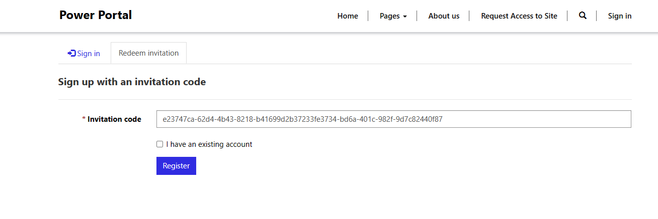
Request Portal Access Workflow
User submits Portal Access Request Form
Record created in Dataverse Portal Access Table
Power Automate Workflow Triggered
Power Automate Approval Workflow
Sends upload request approval to management team
External users
Anonymous can only see Request Portal Access Form
Power Automate automatically creates new user with Web Role Security Permissions and registration code.
User Redirected to Portal Registration with code
User Email Validated
User logs in with MFA required

Slide 5
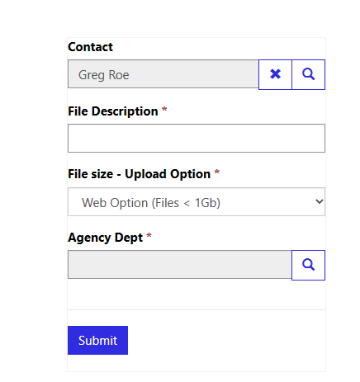
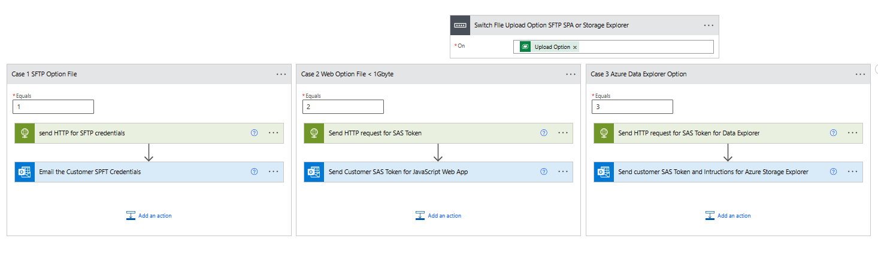

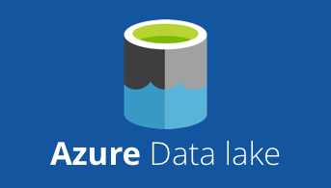
Request File Upload Workflow
User submits File Upload Request Form
Record created in Dataverse Request Table
Power Automate Workflow Triggered
Power Automate Approval Workflow
Sends upload request approval to management team
External users
User securely signs into Power Pages Portal
Power Automate HTTP Action Calls Azure Function and Creates Datalake SAS Access Token, or SFTP Credentials
Power Automate Outlook Send Mail Action send customer the secure Datalake SAS Token, or SFTP Credentials
Customer uploads files
Azure Storage Explorer SAS Token Option
JavaScript SPA hosted in Power Portal Option
SFTP credentials for Azure Storage Option Account/Datalake
Giga byte Files securely uploaded to Datalake

Slide 6

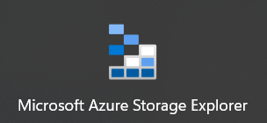
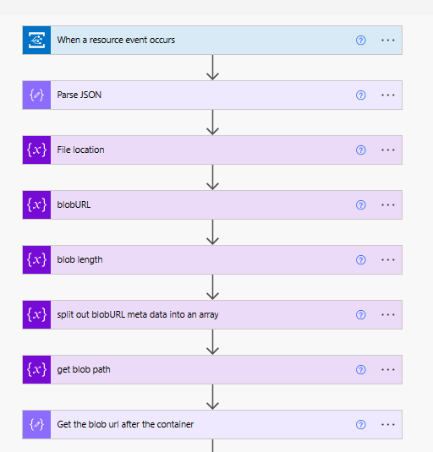
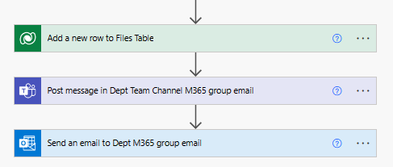
New File uploaded notification Workflow
External user uploads file(s) with SAS Token
File Stored in Datalake
New blob event fires in Azure Event Grid
Power Automate Workflow Triggered
Power Automate reads blob metadata, stores in Files Table, and send notification
Internal customer new file notification in Outlook and Teams
File metadata stored in Files History (audit) table

Slide 7
